Slide 1
Airline Analytics
Nagesh Ramamoorthy

Slide 2
Basic Idea
Regardless of data size, our Airline Analytics should provide insights quickly from data analysis.
Analytics users who are tired and having to go through multiple dashboards(Tableau, QlikView) will get insights which are in form of text and can be easily understandable.
Insights will be presented in terms of a storyboard.
Storyboards provide users with wide variety of benefits which include contextual, actionable and consumable insights.

Slide 3
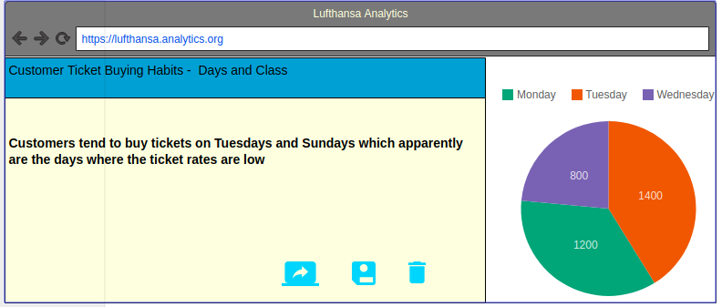
Insights Moqup - 1

Slide 4
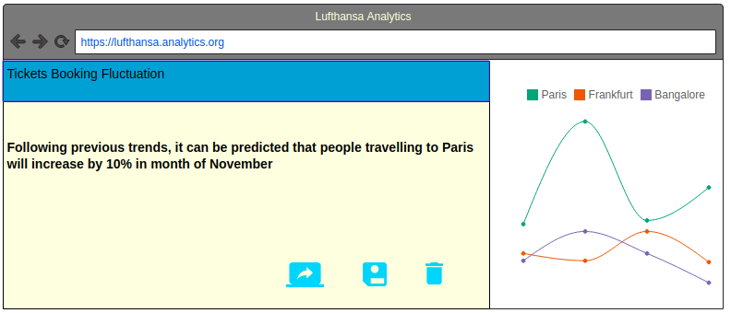
Insights Moqup - 2

Slide 5
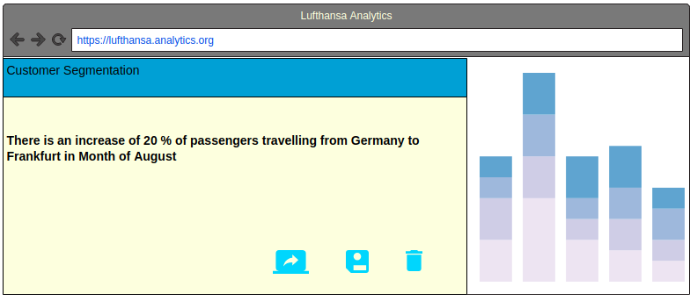
Insights Moqup - 3

Slide 6
Target Areas
Customer Sales
Improved Marketing Efforts
Internal Use – Safety, Fuel efficiency

Slide 7
Approach
Data Engineering
Data Analysis - Machine Learning Approaches
GUI - Presenting Storyboards of insights obtained from analysis

Slide 8
Thank You

